Slide 1
DGIST
Team Project Proposal:
Cache Partitioning &Write-Scheduling in Demand-based FTL
Real-time Embedded Systems (IC616)
201842003 Junsu Im
201822020 Jinwook Bae
Data-Intensive Computing Systems Laboratory(DataLab), DGIST

Slide 2
Index
DGIST
Introduction
Background
Motivation
PTSD
Future Work

Slide 3
Index
DGIST
Introduction
Background
Motivation
PTSD
Future Work

Slide 4


Introduction
DGIST
Real-time apps need to store, retrieve and process large volume of sensor data
Unmanned Aerial Vehicles(UAVs)
Autonomous Cars
Because of lack of the system memory, the file I/Os are occur
To satisfy Real Time processing, the File I/O should be predictable.
read operations can’t be handled as asynchronous way, it is more important than write operations.

Slide 5
Introduction
DGIST
SSD instead of HDD must be adopted to meet requirements of real-time systems
Fast access time
Shock resistance
Low power consumption
However, For SSDs, DRAM is required in proportion to the size of storage
to store massive data generated from sensors, more memory is needed
Why SSD need DRAM?
Logical to Physical address mapping

Slide 6
Index
DGIST
Introduction
Background
Motivation
PTSD
Future Work

Slide 7
Background
DGIST
Address Mapping
LPA
0
1
2
3
4
5
6
7
8
9
10
11
?
LPA
PPA
a’
b’
c’
a
b
c
d
e
f
g
h
i
j
0 | 4
1 | 5
2 | 6
3 | 3
4
5
6 | 7
7 | 8
8 | 9
9 | 10
10 | 11
11
a
b
c
d
a’
b’
c’
e
f
g
h
i
PPA
0
1
2
3
4
5
6
7
8
9
10
11

Slide 8
Background
DGIST
Garbage Collection
LPA
0
1
2
3
4
5
6
7
8
9
10
11
a’
b’
c’
a
b
c
d
e
f
g
h
i
j
Block Erase!
a
b
c
d
a’
b’
c’
e
f
g
h
i
d
j
PPA
0
1
2
3
4
5
6
7
8
9
10
11
12
13
14
15
Over-Provisioning

Slide 9
Index
DGIST
Introduction
Background
Motivation
PTSD
Future Work

Slide 10
Motivation
DGIST
 | Write Amplification Factor | Read Latency | Memory Usage
Hybrid Mapping | Over 10x | Partially Guarantee | Middle, variable size
Block Mapping | Over 30x | Partially Guarantee | Very low, fixed size
Demand Page Mapping | Over 2x | Rarely Guarantee | Middle, variable size
Page Mapping | Optimal | Optimal | Very high, fixed size
Hybrid, Block mapping can guarantee read response time in some case, but it cause a lot of additional writes.
Demand Page Mapping’s write operation is quite similar to optimal, but it can’t guarantee read in many cases.
Similar to demand paging in virtual memory
Page mapping is not adoptable in embedded system because of memory usage.

Slide 11
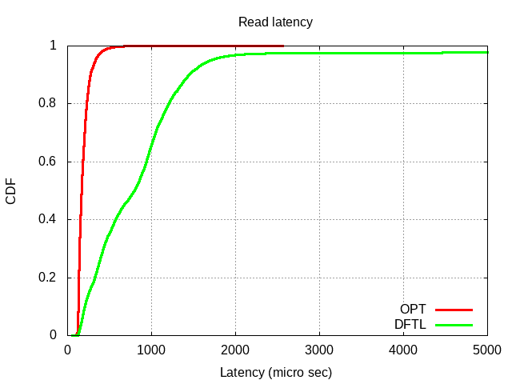
Motivation
DGIST
Dirty Eviction + GC
Clean Eviction
Cache Hit

Slide 12
Index
DGIST
Introduction
Background
Motivation
PTSD
Cache Partitioning
I/O Scheduling
Write Optimizing
Future Work

Slide 13
PTSD
DGIST
PTSD:cache ParTitioning and I/O-Scheduling in Demand-based FTL
Mapping cache for reads and writes are partitioned into two regions
Remove dirty eviction from read I/O path
Protect reads from write disturbance by I/O scheduling
Main functionalities
Cache Partitioning
I/O scheduling
Write optimizing

Slide 14
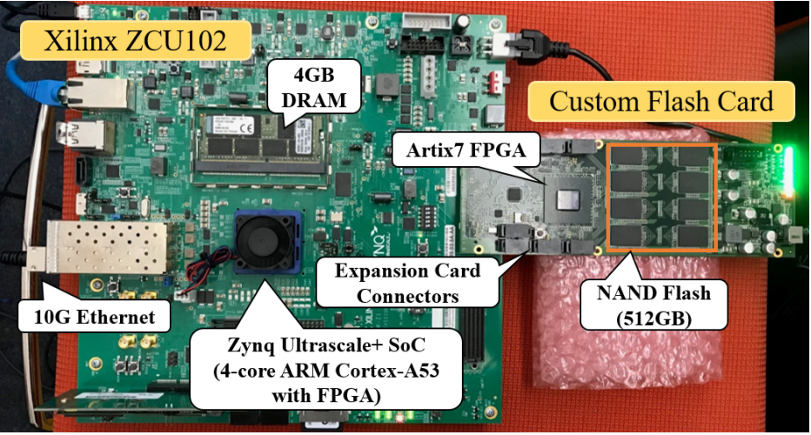
PTSD
DGIST
Experiments
I/O performance is tested in mixed workload(R/W 5:5) after filling device
Sequential Write + Mixed Random Read/Write
Each FTL and Functionality is implemented as C program in userspace
We evaluated on the embedded board which is simulating the SSD
Xilinx ZCU 102
512GB Capacity
4GB DRAM
4 1GHz ARM Cores

Slide 15
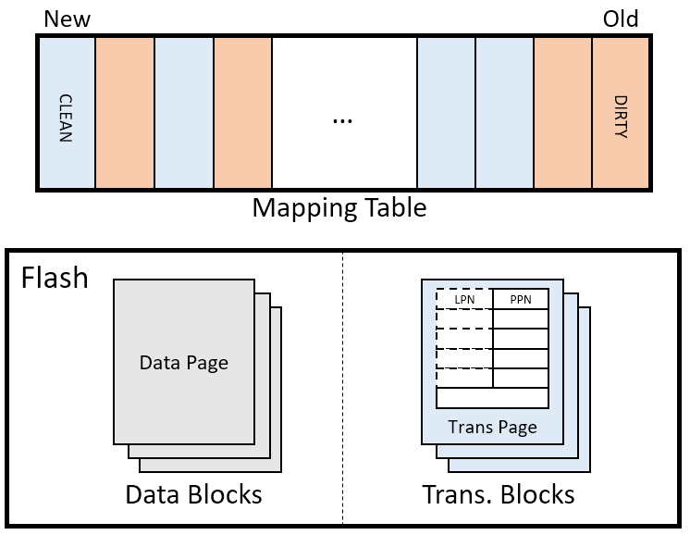

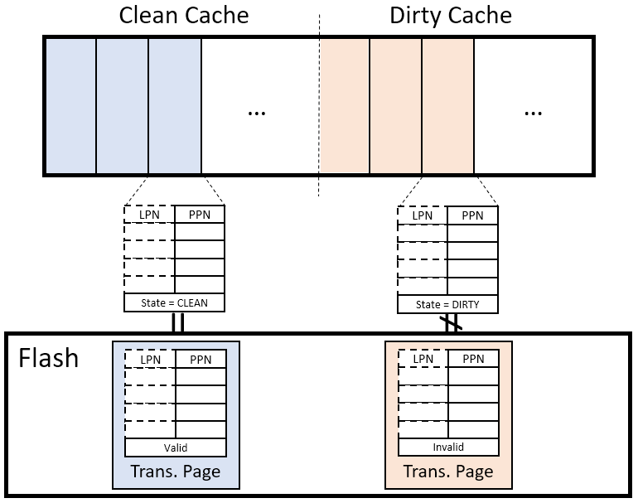
PTSD
DGIST
Read
Write
Cache Partitioning
Separate Clean/Dirty cache
Only clean eviction occurs on read
Dirty evictions are all imputed to write
Cache utilization could be a drawback
Dirty eviction…
Dirty eviction…
Clean eviction…
Clean eviction…
Cache Partitioning
Read
Write
Clean eviction…
Dirty eviction…
Clean eviction…
Dirty eviction…

Slide 16
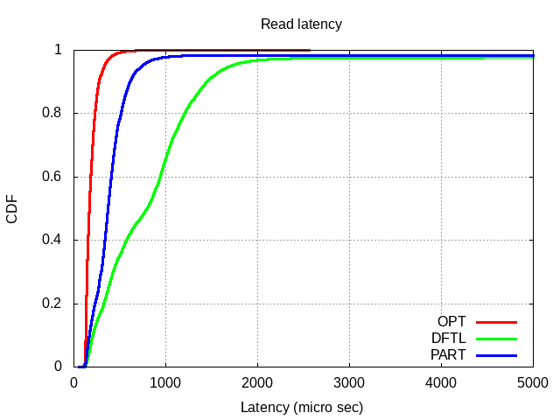
PTSD
DGIST
Cache Partitioning
Block by writes?
Context switch?
Tail latency still exists…
Good average latency!

Slide 17
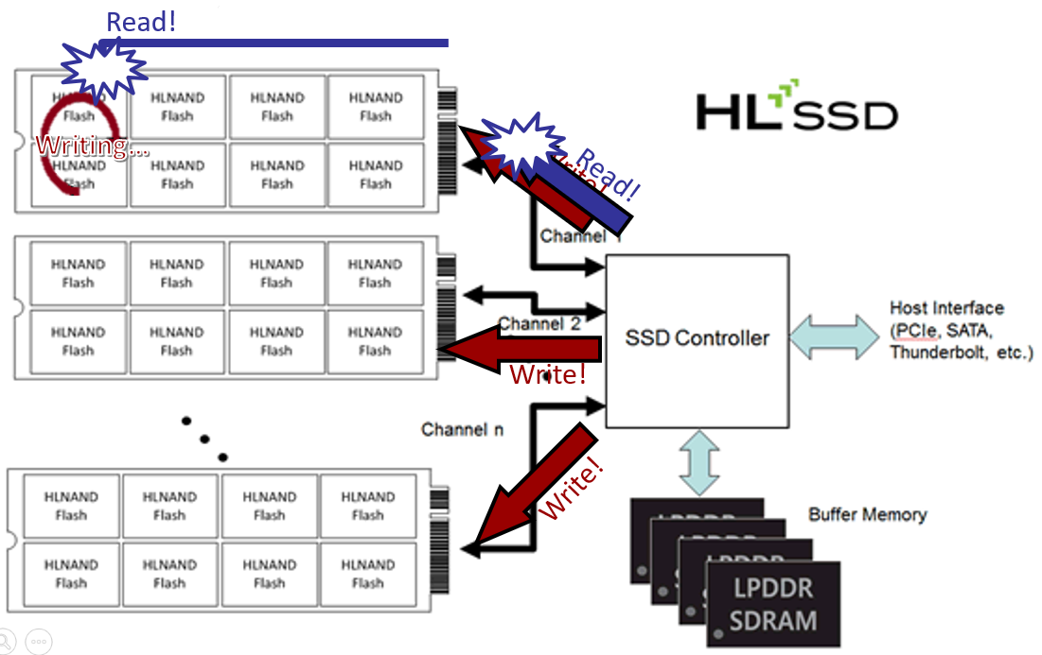
PTSD
DGIST
​I/O Scheduling
force writes to stop when reads are waiting
Writes are flushed only when the read I/O queue is empty
After flush, we clean the device until write requests are finished

Slide 18
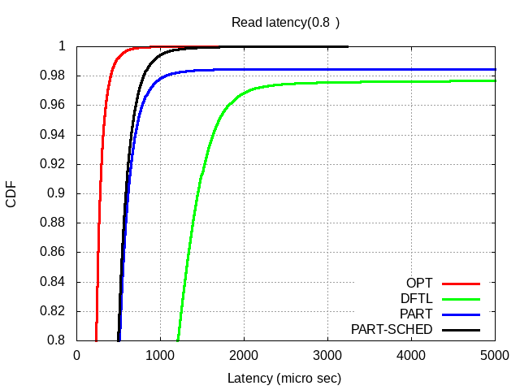
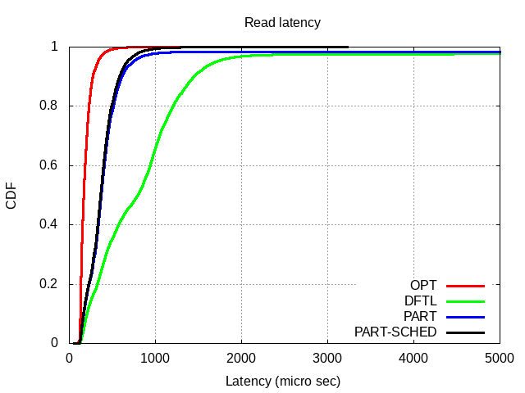
PTSD
DGIST
​I/O Scheduling
Good Tail Latency!

Slide 19
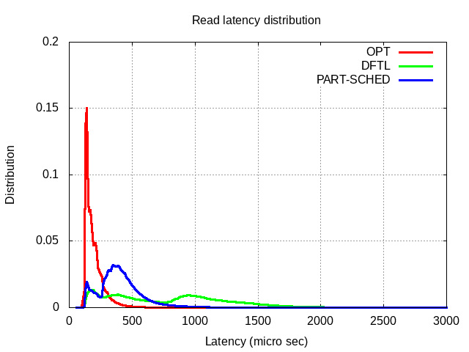
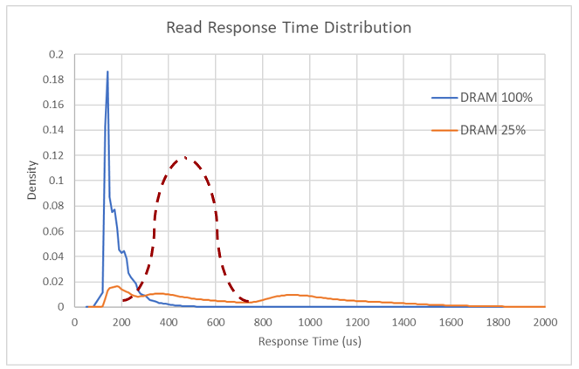
PTSD
DGIST
​I/O Scheduling

Slide 20
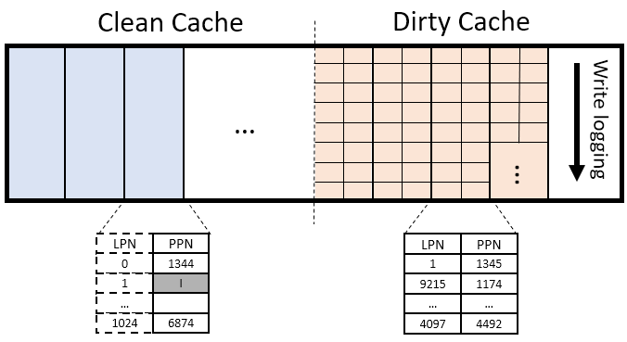
PTSD
DGIST
Write Optimizing
Same mapping granularity in both cache is inefficient
In dirty cache, the clean entry in dirty page can occupy the cache memory
Also this effect more affect to write performance degrading with cache partitioning and I/O scheduling

Slide 21
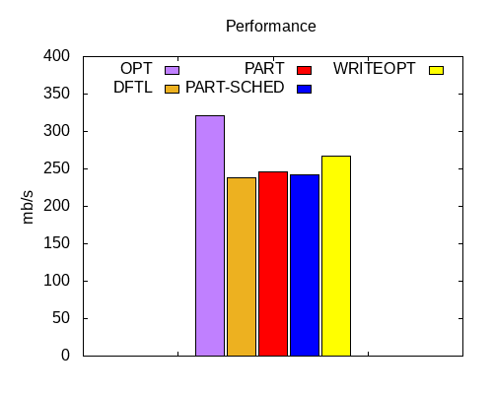
PTSD
DGIST
Write Optimizing

Slide 22
Index
DGIST
Introduction
Background
Motivation
PTSD
Future Work

Slide 23
Future work
DGIST
Limitation of I/O scheduling
we just force to stop write services at software level, rather than hardware support
This approach hides read tail latency to write requests
If software I/O queue is overflowed out of limited queue depth, reads are delayed by writes in the end
Adaptive partitioning
we expect that the optimal partitioning point for given workload is exists
adaptive partitioning by detecting workload in runtime would be effective to meet requirements adjustably

Slide 24
DGIST
Q & A

